Slide 1
INTRODUCTION TO COMPUTERS
EPROG
COMPUTER FUNDAMENTALS & PROGRAMMING FOR ENGINEERING STUDENTS
<<professor>>

Slide 2
What is a computer?
an electronic device that manipulates information, or "data“
not a glorified typewriter
has the ability to store, retrieve, and process data
<number>
Notes:
<number>

Slide 3
History of Computers
Notable People in the History of Computers
Charles Babbage
Seymour Cray
Steve Jobs
Lady Ada Augusta Lovelace
Alan Mathison Turing

Slide 4
History of Computers
Charles Babbage
A mathematician, philosopher, inventor and mechanical engineer
Babbage is best remembered for originating the concept of a programmable computer.
Invented the Difference Engine and Analytical Engine
Considered as "the "father of the computer"

Slide 5
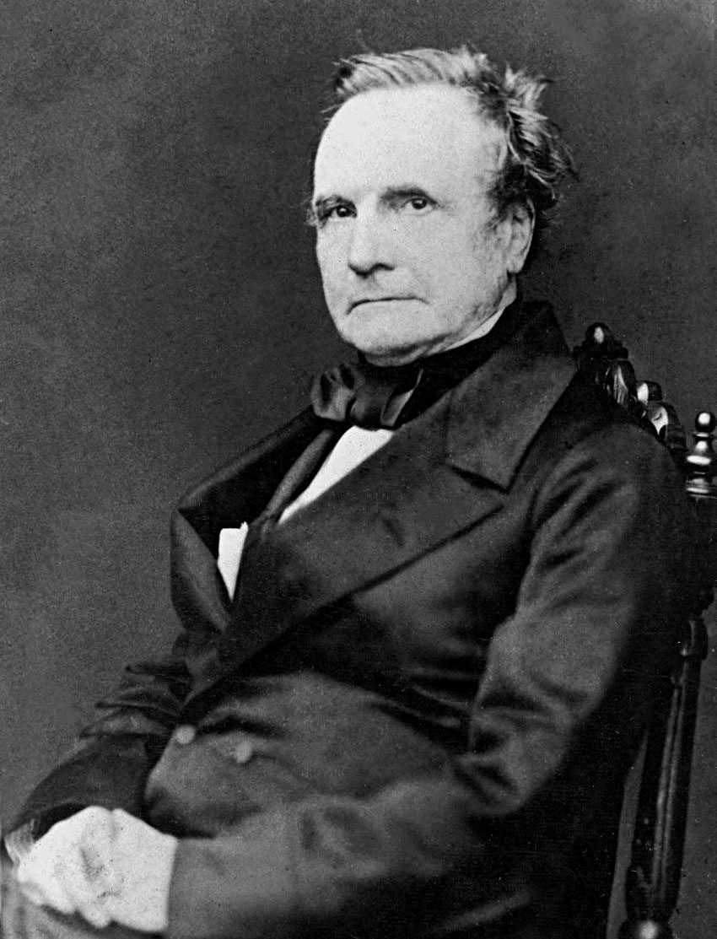
History of Computers
Charles Babbage

Slide 6
History of Computers
Seymour Cray
was an American electrical engineer and supercomputer architect who designed a series of computers that were the fastest in the world for decades
Considered as "the father of supercomputing“

Slide 7
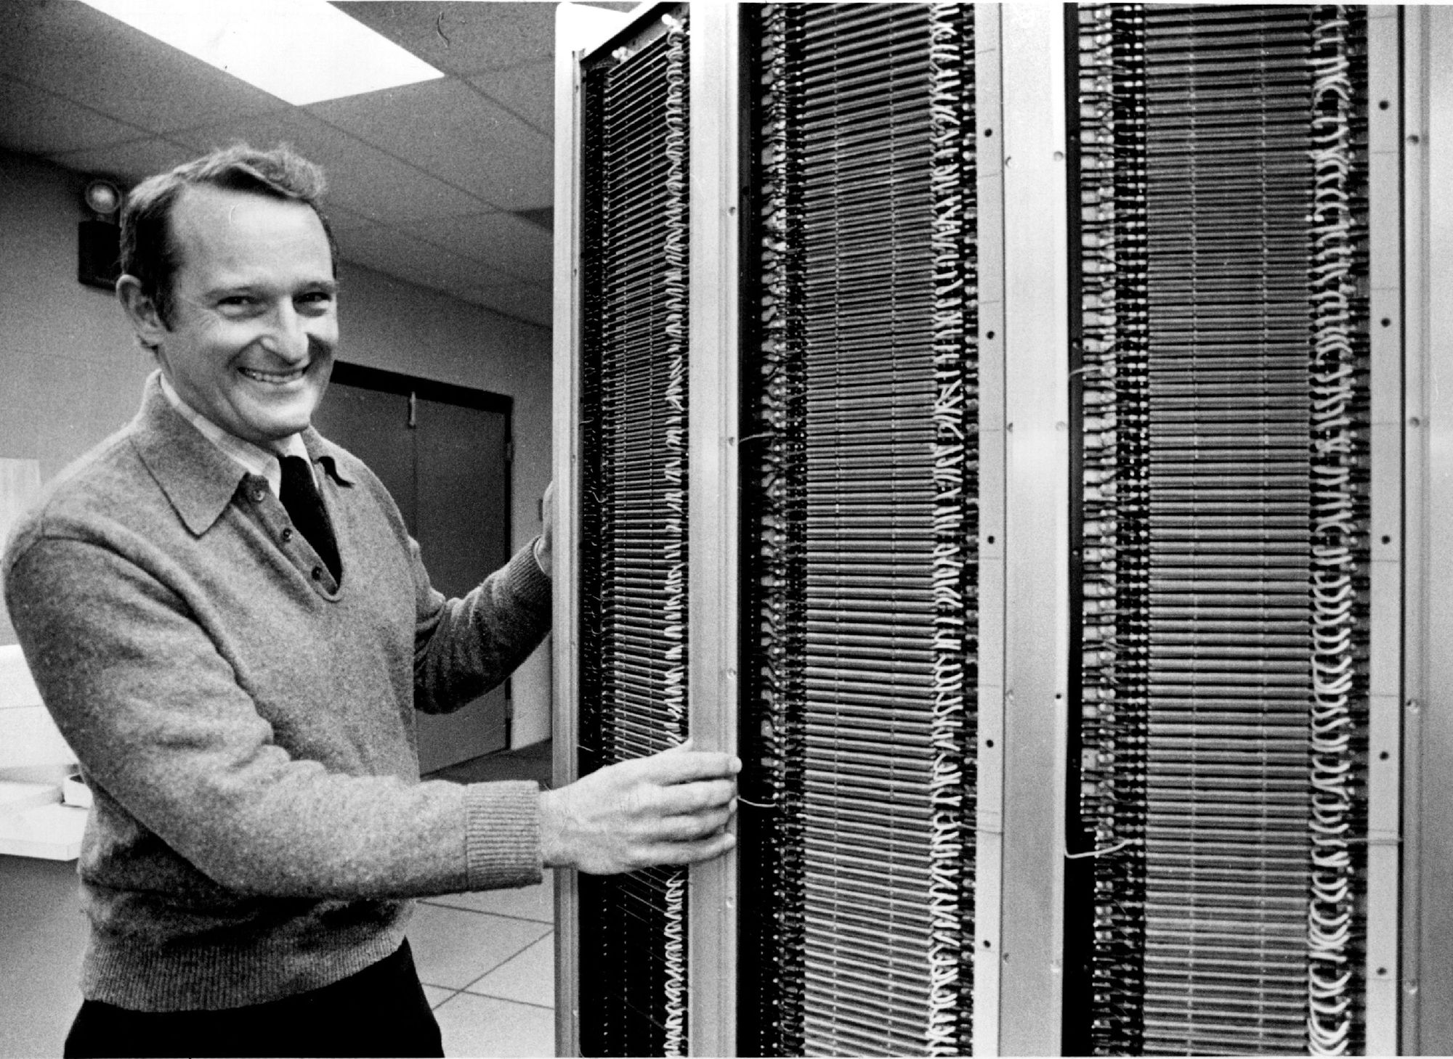
History of Computers
Seymour Cray

Slide 8
History of Computers
Steve Jobs
Pioneer of the personal computer revolution with Steve Wozniak
was an American information technology entrepreneur and inventor.
a co-founder, chairman, and chief executive officer (CEO) of Apple Inc.

Slide 9
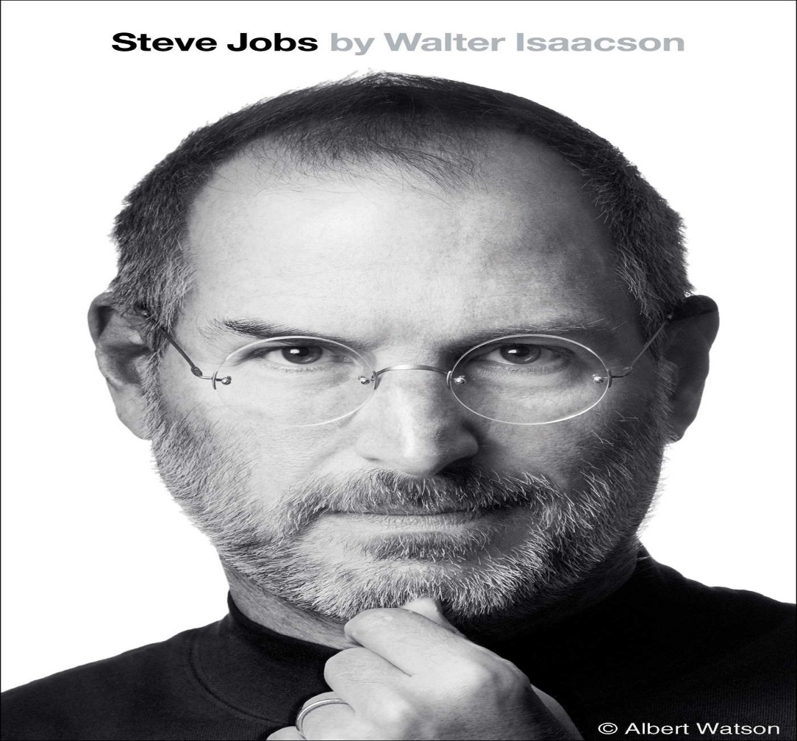
History of Computers
Steve Jobs

Slide 10
History of Computers
Lady Ada Augusta Lovelace
chiefly known for her work on Charles Babbage's early mechanical general-purpose computer, the Analytical Engine.
Her notes on the engine include what is recognized as the first algorithm intended to be carried out by a machine.
known as the first computer programmer

Slide 11
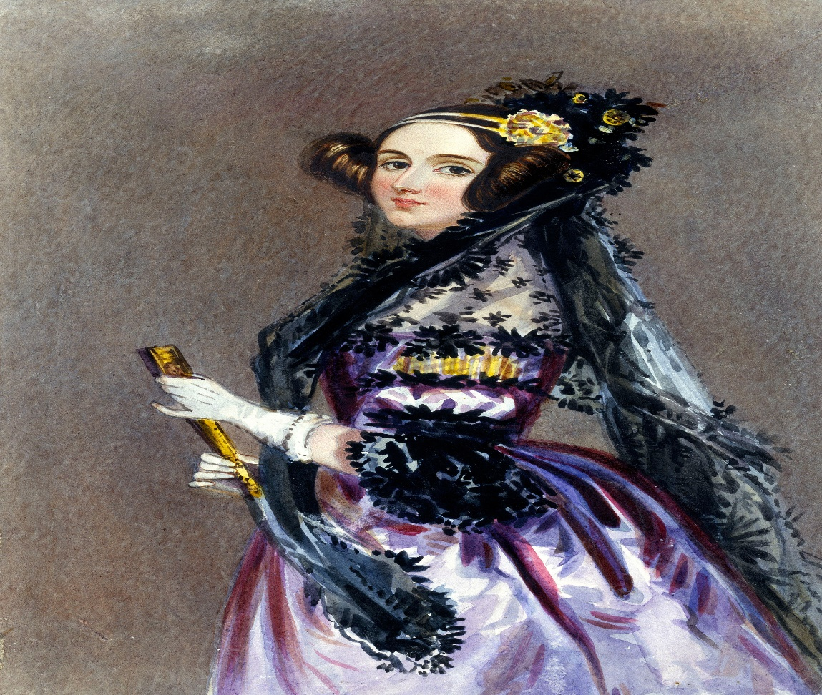
History of Computers
Lady Ada Augusta Lovelace

Slide 12
History of Computers
Allan Mathison Turing
He was highly influential in the development of theoretical computer science, providing a formalization of the concepts of algorithm and computation with the Turing machine, which can be considered a model of a general purpose computer.
widely considered to be the father of theoretical computer science and artificial intelligence.

Slide 13
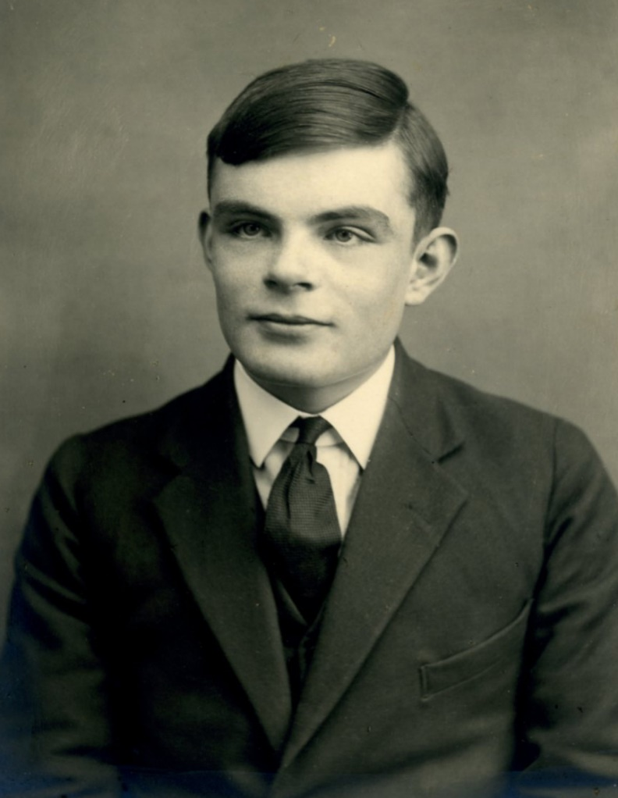
History of Computers
Allan Mathison Turing

Slide 14
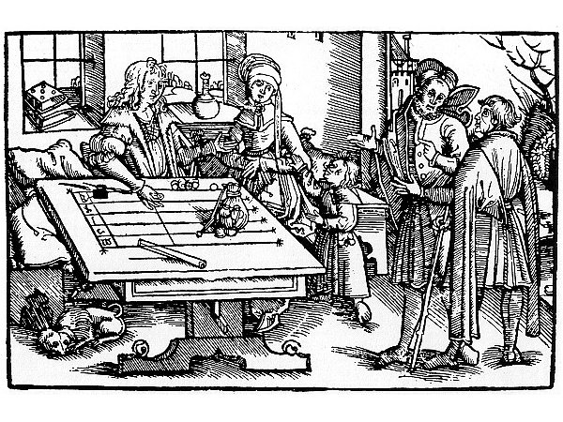
Counting Tables
Picture of ancient counting tables

Slide 15
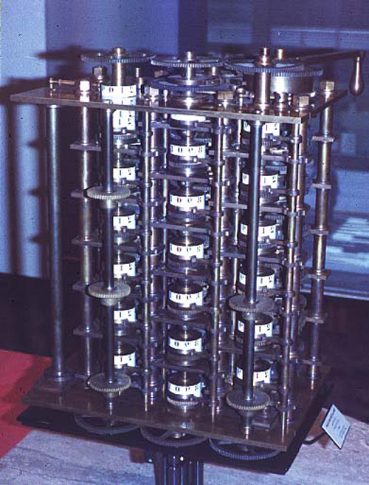
Charles Babbage
By 1822 the English mathematician Charles Babbage was proposing a steam driven calculating machine the size of a room, which he called the Difference Engine.

Slide 16
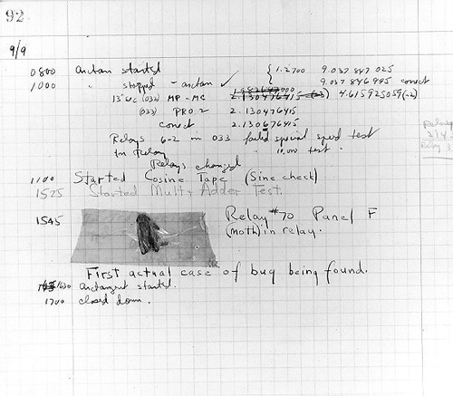
The First Bug
One of the primary programmers for the Mark I was a woman, Grace Hopper.
Hopper found the first computer "bug": a dead moth that had gotten into the Mark I
The word "bug" had been used to describe a defect since at least 1889 but Hopper is credited with coining the word "debugging" to describe the work to eliminate program faults.

Slide 17
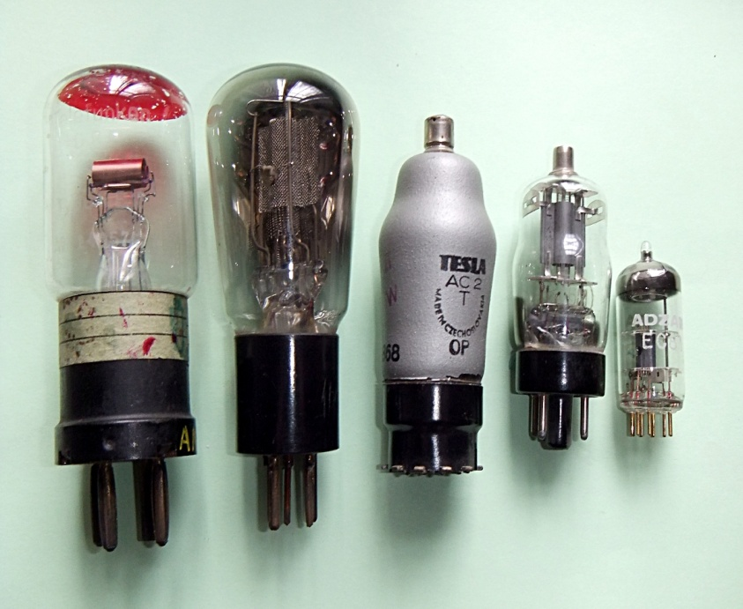
First Generation Computers
The first electronic computer was designed at Iowa State between 1939-1942
The Atanasoff-Berry Computer used the binary system(1’s and 0’s).
Contained vacuum tubes and stored numbers for calculations by burning holes in paper

Slide 18
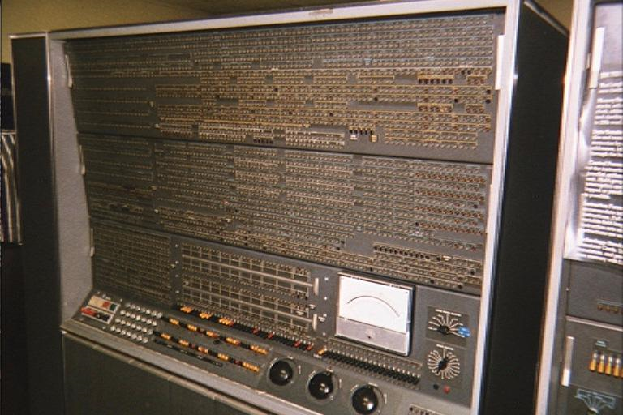
IBM Stretch - 1959
Notes:
<number>
Start here today!!

Slide 19
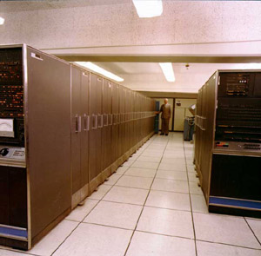
IBM Stretch - 1959

Slide 20
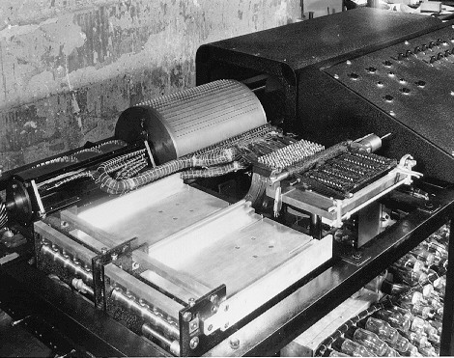
Atanasoff – Berry Computer
One of the earliest attempts to build an all-electronic (that is, no gears, cams, belts, shafts, etc.) digital computer occurred in 1937 by J. V. Atanasoff,
This machine was the first to store data as a charge on a capacitor, which is how today's computers store information in their main memory (DRAM or dynamic RAM). As far as its inventors were aware, it was also the first to employ binary arithmetic.

Slide 21
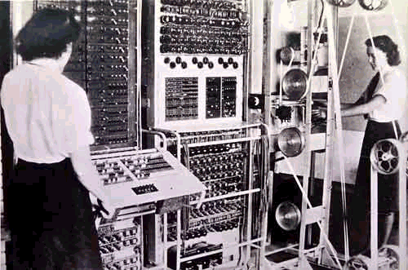
Colussus
The Colossus, built during World War II by Britain for the purpose of breaking the cryptographic codes used by Germany.
Britain led the world in designing and building electronic machines dedicated to code breaking, and was routinely able to read coded Germany radio transmissions.
Not a general purpose, reprogrammable machine.

Slide 22
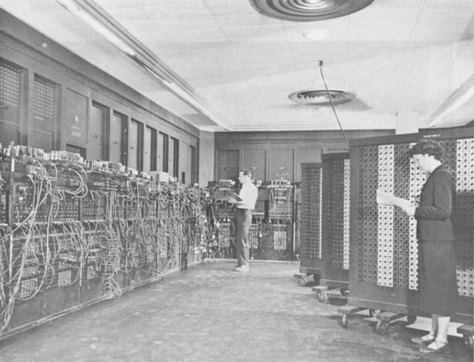
ENIAC

Slide 23
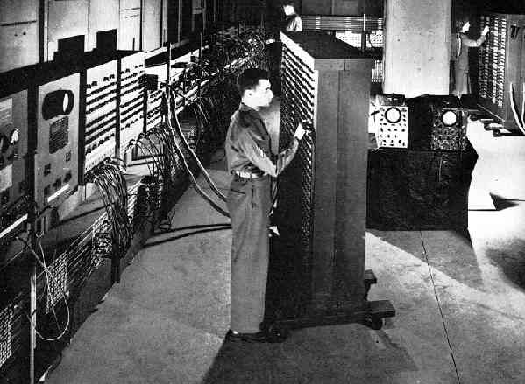
ENIAC

Slide 24
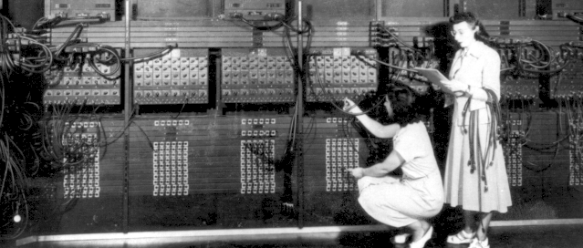
Programming the ENIAC

Slide 25
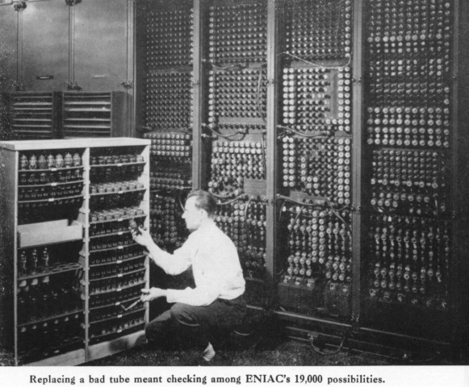
Replacing a vacuum tube

Slide 26
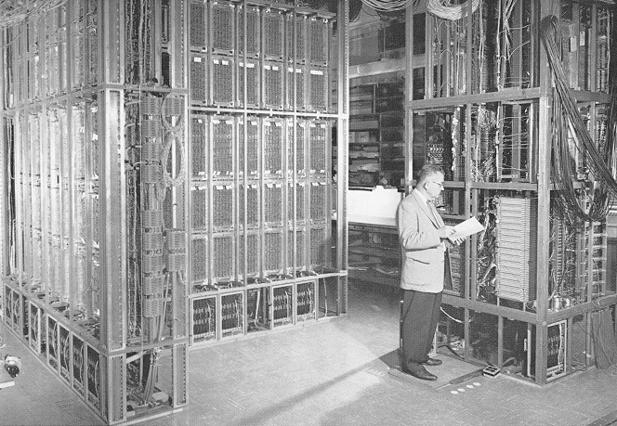
Edvac
It took days to change ENIAC's program.
Eckert and Mauchly's next teamed up with the mathematician John von Neumann to design EDVAC, which pioneered the stored program.
After ENIAC and EDVAC came other computers with humorous names such as ILLIAC, JOHNNIAC, and, of course, MANIAC

Slide 27
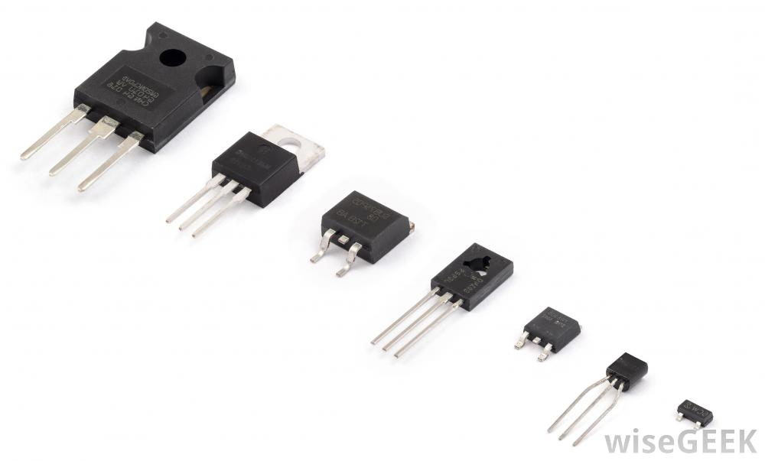
Second Generation Computers
In 1947, the transistor was invented
The transistor made computers smaller, less expensive and increased calculating speeds.

Slide 28
Second Generation Computers
Second generation computers also saw a new way data was stored
Punch cards were replaced with magnetic tapes and reel to reel machines

Slide 29
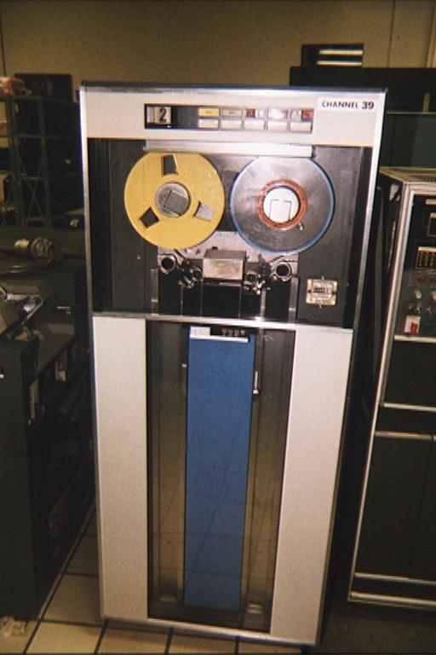
Univac
The UNIVAC computer was the first commercial (mass produced) computer.
In the 50's, UNIVAC (a contraction of "Universal Automatic Computer") was the household word for "computer" just as "Kleenex" is for "tissue".
UNIVAC was also the first computer to employ magnetic tape.

Slide 30
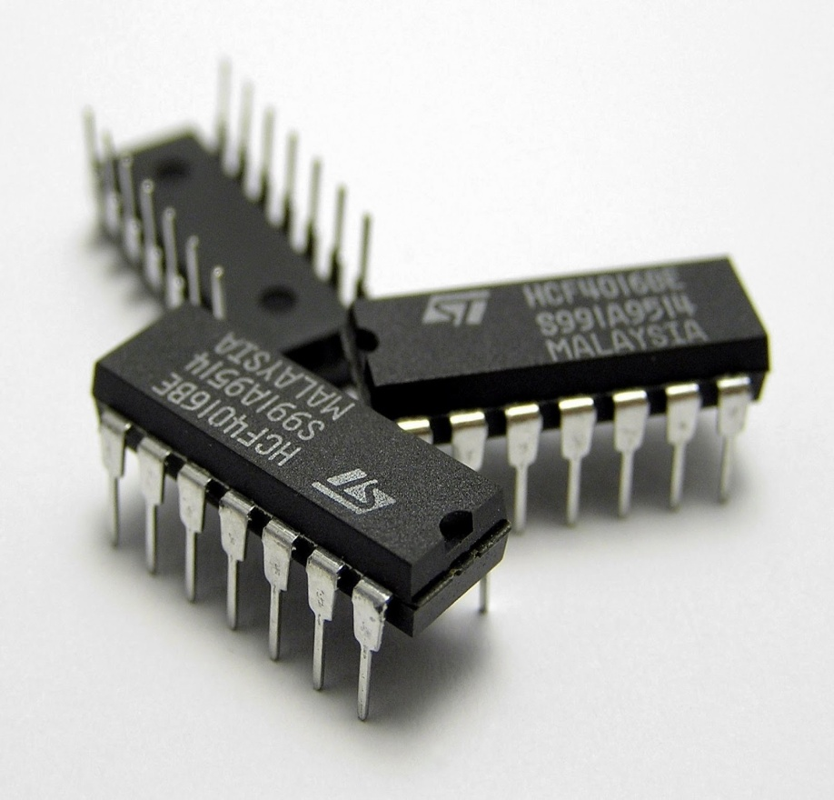
Third Generation Computers
Transistors were replaced by integrated circuits(IC)
One IC could replace hundreds of transistors
This made computers even smaller and faster.

Slide 31
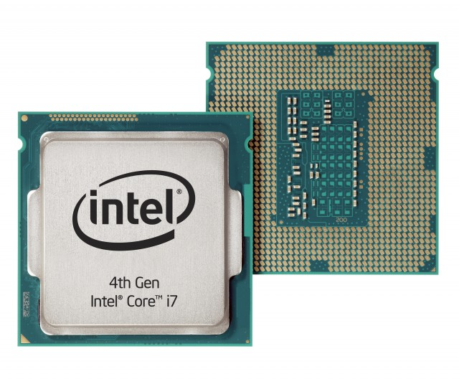
Fourth Generation Computers
In 1970 the Intel Corporation invented the Microprocessor:an entire CPU on one chip
This led to microcomputers-computers on a desk

Slide 32
Fifth Generation of Computers
referred to as future computers
proposed to be as intelligent and capable as a human being
self-sufficient to a very large storage capacity from the previous computers

Slide 33
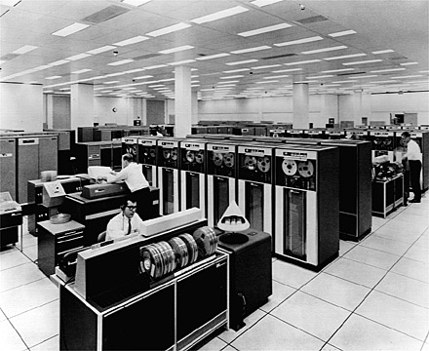
Computer Programming in the ’70’s
If you learned computer programming in the 1970's, you dealt with what today are called mainframe computers, such as the IBM 7090 (shown below), IBM 360, or IBM 370.

Slide 34
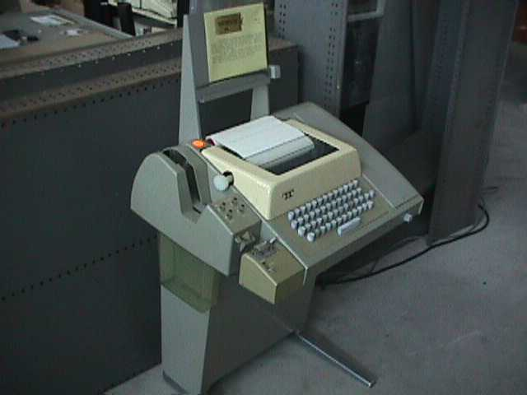
Time-Sharing
There were 2 ways to interact with a mainframe.
The first was called time sharing because the computer gave each user a tiny sliver of time in a round-robin fashion.
Perhaps 100 users would be simultaneously logged on, each typing on a teletype such as the following:

Slide 35
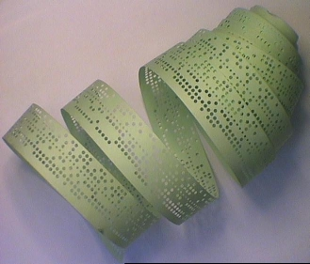
Teletype
A teletype was a motorized typewriter that could transmit your keystrokes to the mainframe and then print the computer's response on its roll of paper.
You typed a single line of text, hit the carriage return button, and waited for the teletype to begin noisily printing the computer's response

Slide 36
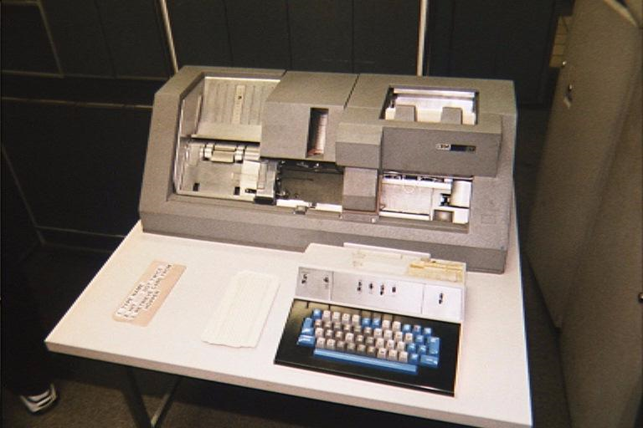
Batch-Mode Processing
The alternative to time sharing was batch mode processing, where the computer gives its full attention to your program.
In exchange for getting the computer's full attention at run-time, you had to agree to prepare your program off-line on a key punch machine which generated punch cards.

Slide 37
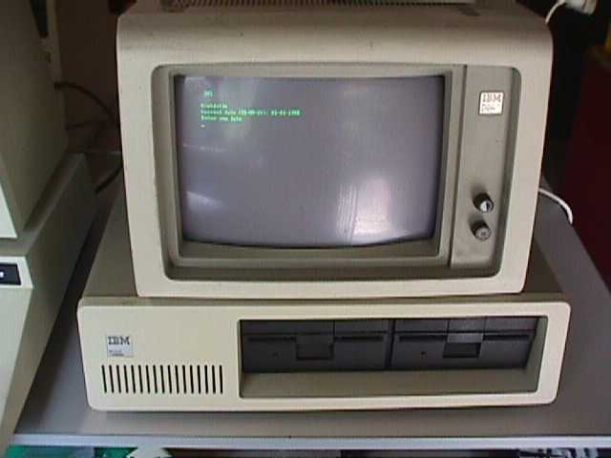
Programming Today
But things changed fast. By the 1990's a university student would typically own his own computer and have exclusive use of it in his dorm room.

Slide 38
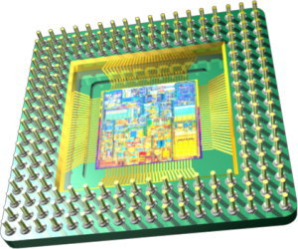
Microprocessor
This transformation was a result of the invention of the microprocessor.
A microprocessor (uP) is a computer that is fabricated on an integrated circuit (IC).
Computers had been around for 20 years before the first microprocessor was developed at Intel in 1971.

Slide 39
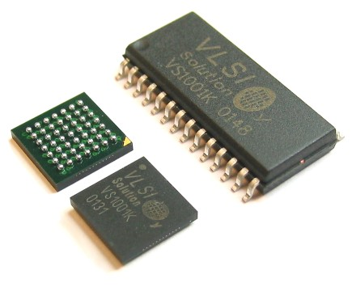
Microprocessor
The micro in the name microprocessor refers to the physical size.
Intel didn't invent the electronic computer, but they were the first to succeed in cramming an entire computer on a single chip (IC)

Slide 40
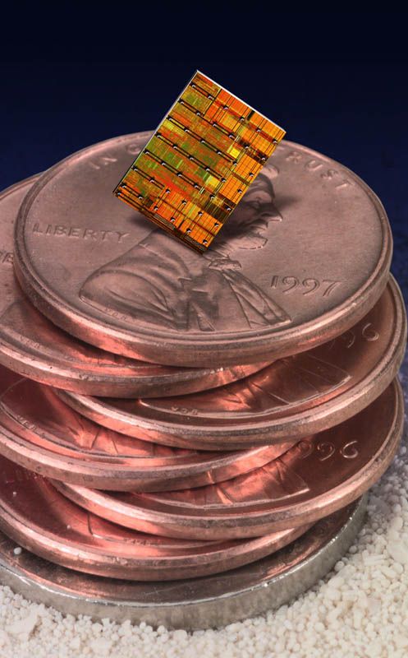
Integrated Circuits
The microelectronics revolution is what allowed the amount of hand-crafted wiring seen in the prior photo to be mass-produced as an integrated circuit which is a small sliver of silicon the size of your thumbnail

Slide 41
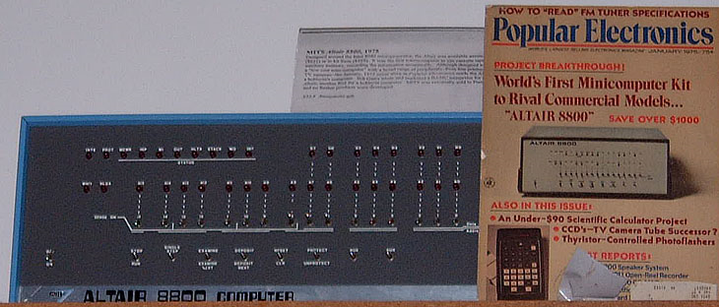
Integrated Circuits
Integrated circuits and microprocessors allowed computers to be faster
This led to a new age of computers
The first home-brew computers is called the ALTAIR 8800

Slide 42
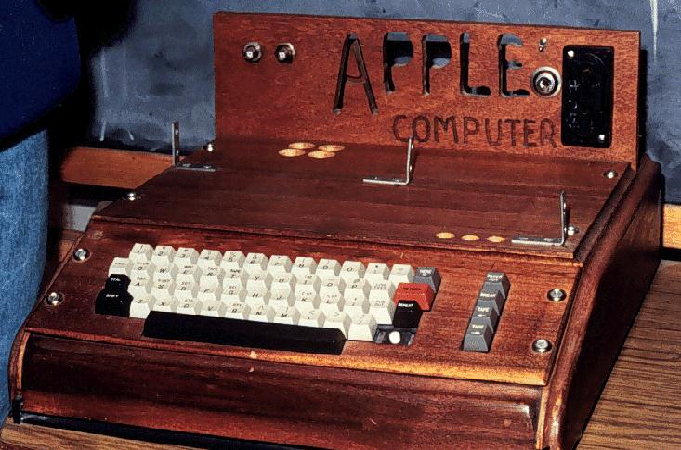
Apple 1 Computer - 1976

Slide 43
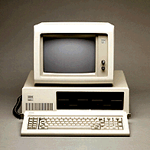
The IBM PC

Slide 44
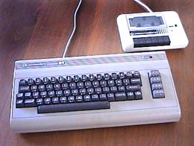
Commodore 64

Slide 45
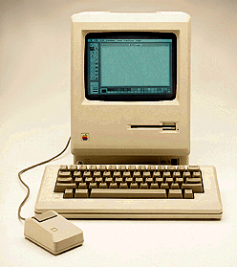
Apple Macintosh

Slide 46
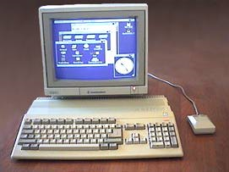
The Amiga

Slide 47
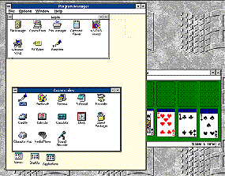
Windows 3

Slide 48
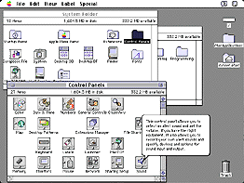
Macintosh System 7

Slide 49
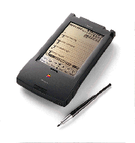
Apple Newton

Slide 50
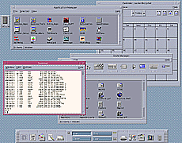
Standard UNIX

Slide 51
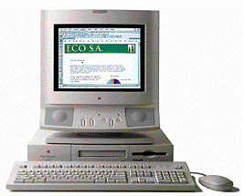
PowerPC

Slide 52
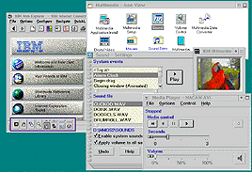
IBM OS/2

Slide 53
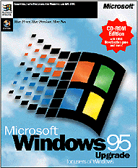
Windows 95

Slide 54
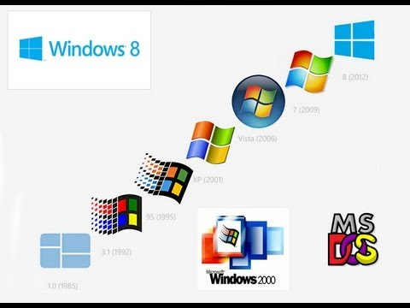
Windows Family

Slide 55
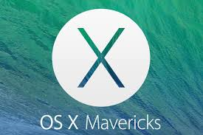
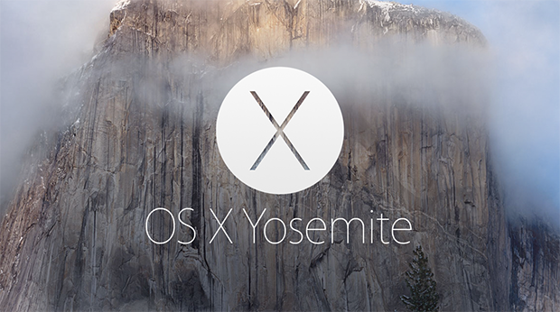
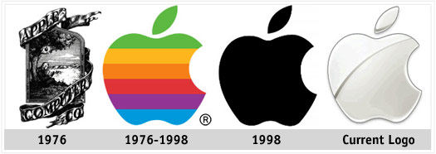
Apple Products

Slide 56
Components of a Computer System
Components are classified into
Hardware
Software
Peopleware
<number>
Notes:
<number>

Slide 57
Hardware
tangible components of a computer
may be an input or an output device
input devices are those used to give something to the computer
i.e. keyboard, mouse
output devices are used to get something from the computer
i.e. monitor, printer

Slide 58
Hardware
may be basic component or a peripheral
basic components are
CPU
monitor
mouse
keyboard
peripherals are
speaker
printer

Slide 59
Software
intangible components of the computer
the programs used to perform specific tasks
may be a system or an application software
System Software
Operating Systems, Library Programs, Utility Programs

Slide 60
Software
Systems Programs
Application Programs
Compilers

Slide 61
Software
Systems Programs
– Programs that are needed to keep all the hardware and software
systems running together smoothly
– Examples: Operating Systems like Linux, Windows, Unix, Solaris,
MacOS

Slide 62
Software
Application Programs
– Programs that people use to get their work done
– Examples: Word Processor, Game programs, Spreadsheets

Slide 63
Software
● Compilers
– Translates computer programs to machine language
– Machine language
● Language that your computer understands.

Slide 64
<number>
Computer Organization
Six logical units in every computer:
Input unit
Obtains information from input devices (keyboard, mouse)
Output unit
Outputs information (to screen, to printer, to control other devices)
Memory unit
Rapid access, low capacity, stores input information

Slide 65
<number>
Computer Organization
4. Arithmetic and logic unit (ALU)
Performs arithmetic calculations and logic decisions
5. Central processing unit (CPU)
Supervises and coordinates the other sections of the computer
6. Secondary storage unit
Cheap, long-term, high-capacity storage
Stores inactive programs

Slide 66
Advantages
Computers have made it easier for us to communicate on a global scale, though the internet has also had a helping hand with this.
We are able to produce documents with ease because of computers. On typewriters, as a comparison, one would either need whiteout or to go back and type over a mistaken letter or grammar issue. Thus, it is easier to correct typed documents.
Documents can also be scanned into computers for editing in various programmes.
We can edit photos, videos, and much more with a computer.
Calculators, calendars, and plenty of other software exist to make computers a necessary part of everyday life.
In essence the main advantage is how easy computers have made life.

Slide 67
Disadvantages
There are certain things upcoming generations are not learning as well because of computers.
For example, computers in a place of business have negated the need for counting back money. When the computer is down those who do not know how to calculate totals in their mind are at a loss.
We seem to spend more time indoors on computers rather than getting exercise given the games, software, and communication aspects computers provide.
Computers are set up with a certain "shelf life" meaning they need replacement and many versions are already obsolete the minute we buy them.
They are also quite costly.

